Slide 1
Chocolate, Lego, Scrum Game Gamemaster Slides

Slide 2

Turn and Talk
What do you know about DevOps?
What is
your name?
What is
your role?

Slide 3
Your Introduction
use Your favorite short introduction,
your twitter handle,
best way to contact you

Slide 4
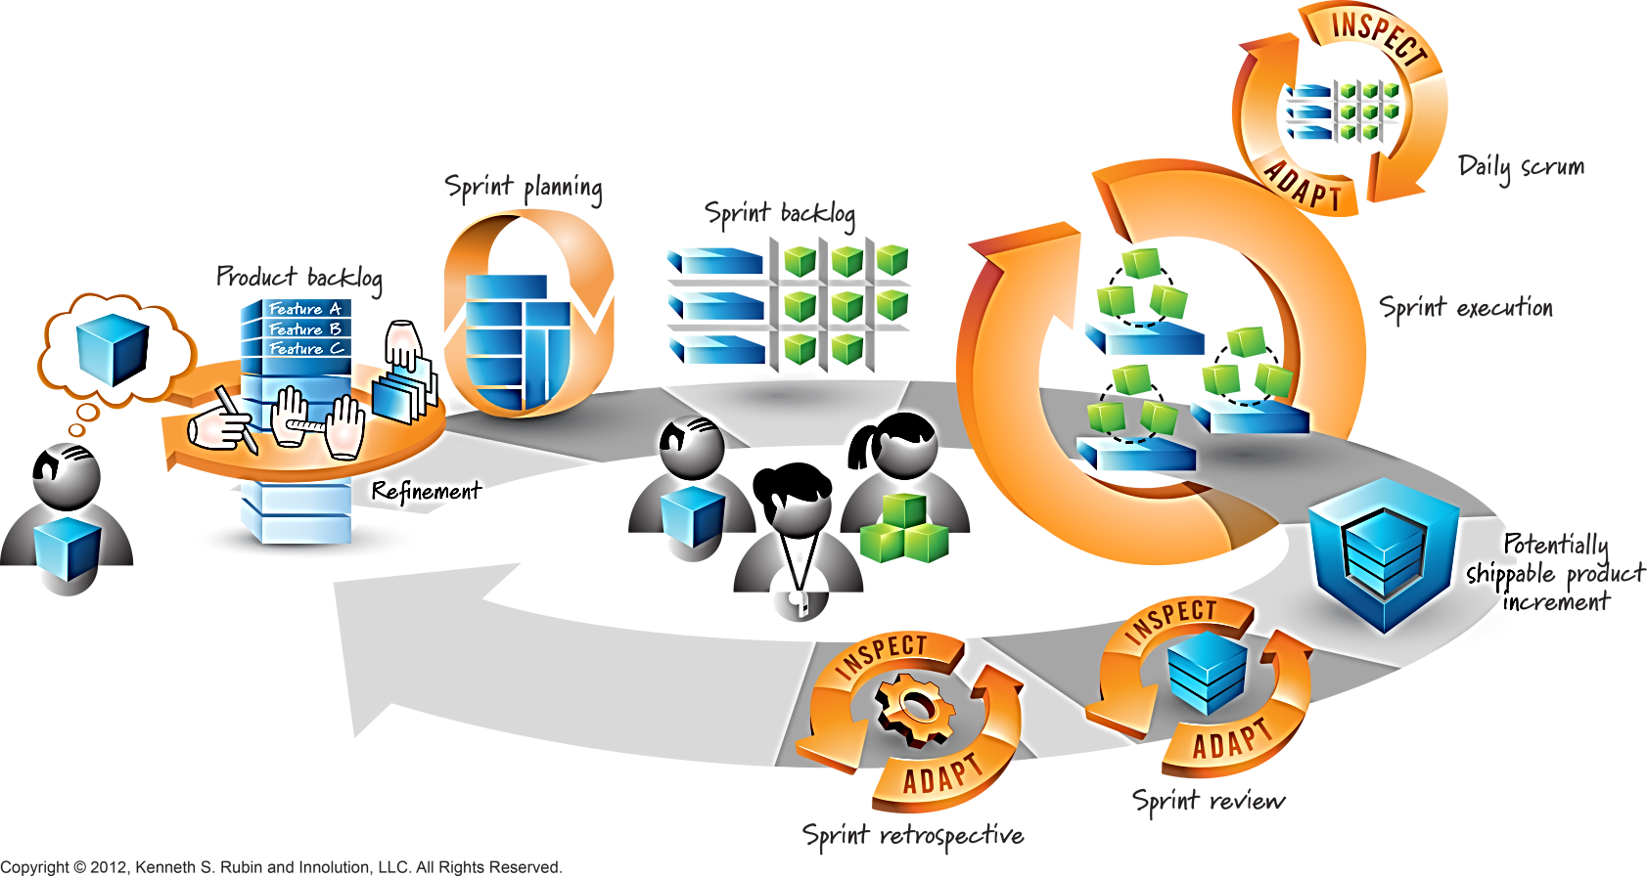




Scrum Team: Focus on Delivery and Speed
Ops Team

Slide 5
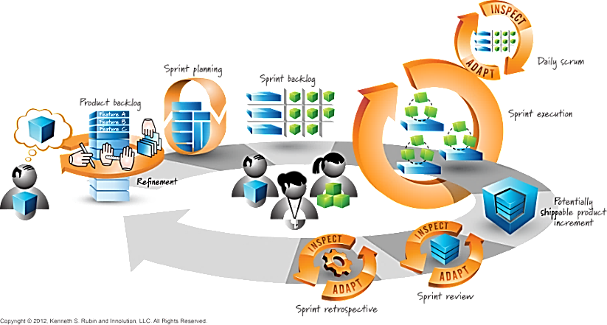

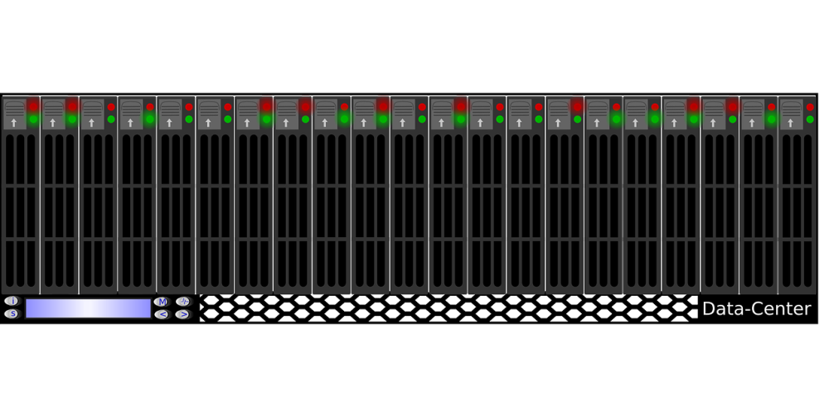
Ops Team: Focus on Stability and Reliability
Pager Duty
On-call support
Monitoring
Upgrades
Security Patching
Backups

Slide 6


Misalignment of Goals
Dev
Team:
Focus on delivery
Focus on Stability
:
Ever-changing demands

Slide 7




Chocolate, LEGO and Scrum Role Playing Game

Slide 8
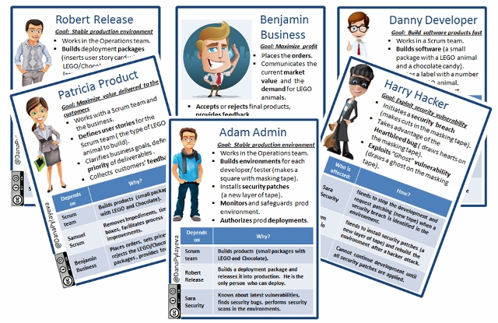
Pick Your Role and Meet Your Team

Slide 9
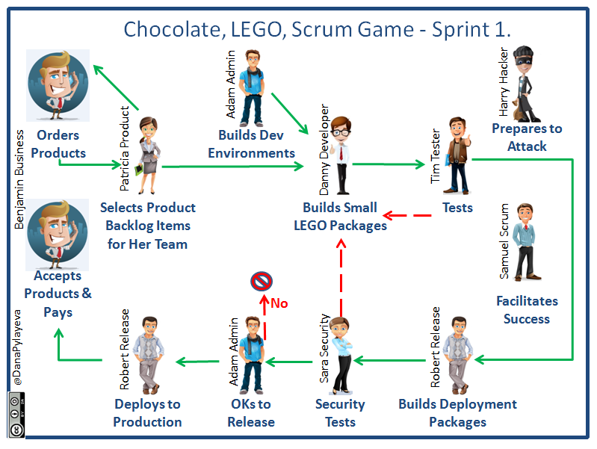

Slide 10
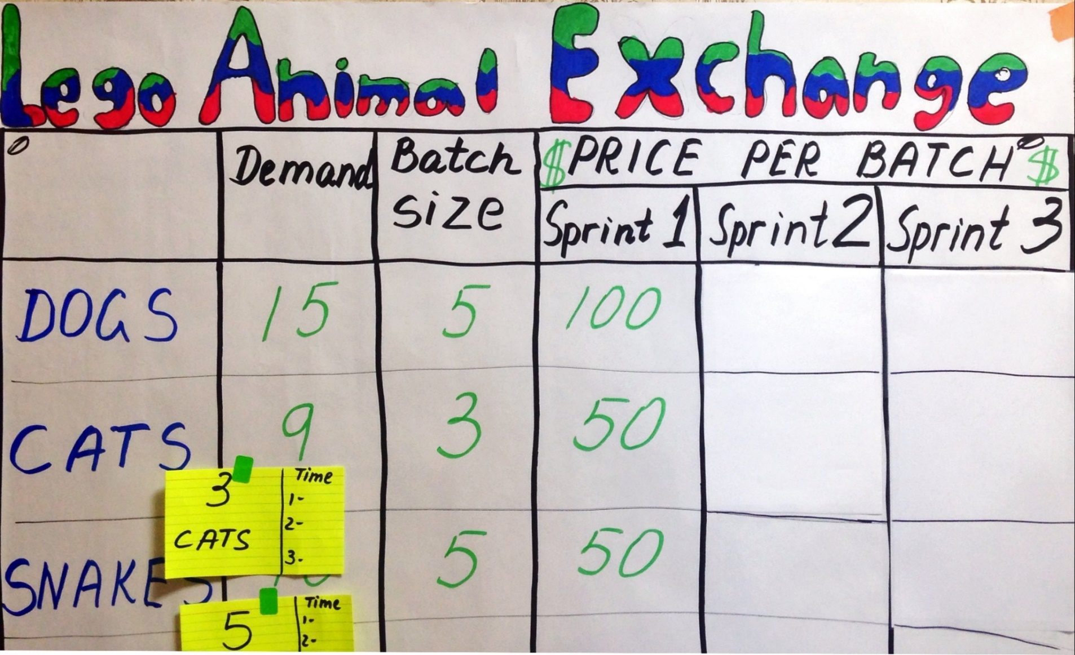

What Will You Build? Ask the Business Team!

Slide 11

Sys Admin
Builds All Environments

Slide 12

Dev Team Builds a Product

Slide 13
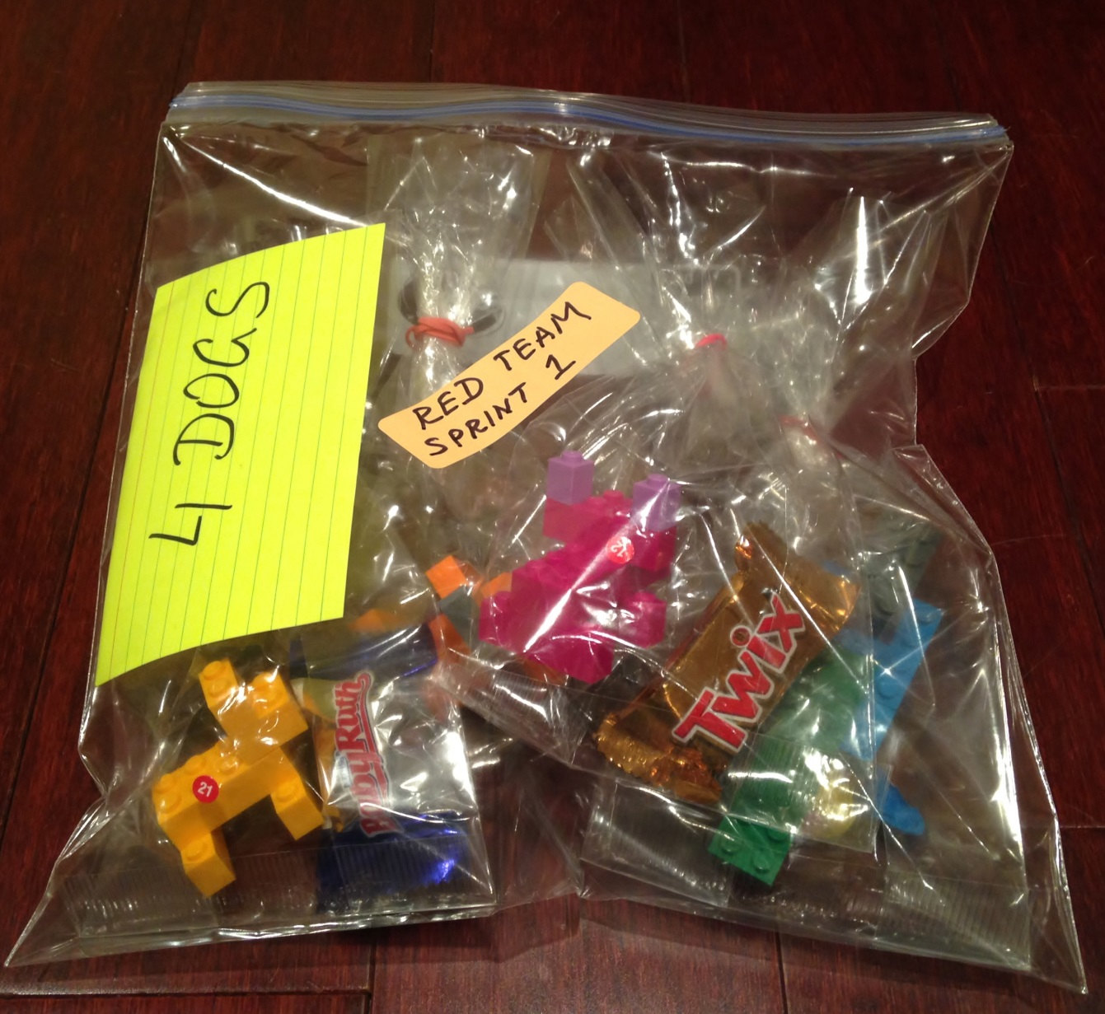
Release Engineer Builds a Deployment Package

Slide 14

Product Owner
gets paid
by the Business
when products are delivered into production.

Slide 15
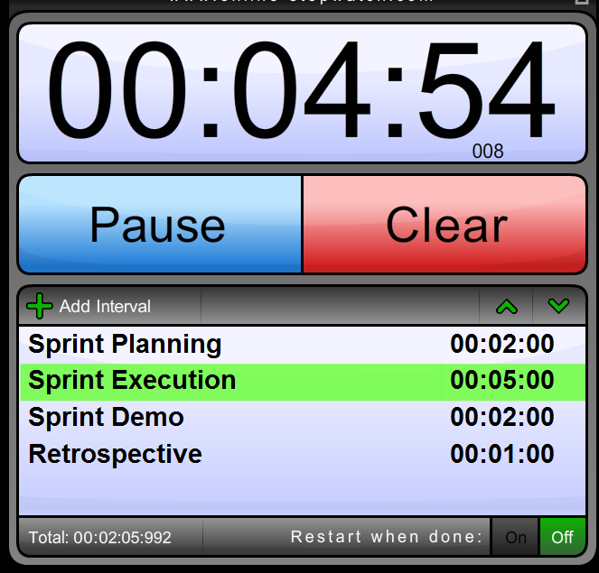
Sprint 1: Cyclical Value Delivery With Scrum
Dev and Ops are separate teams
Sys Admin controls release schedule
Security test is
at the end of the Sprint

Slide 16
What Will You Change For Sprint 2?

Slide 17
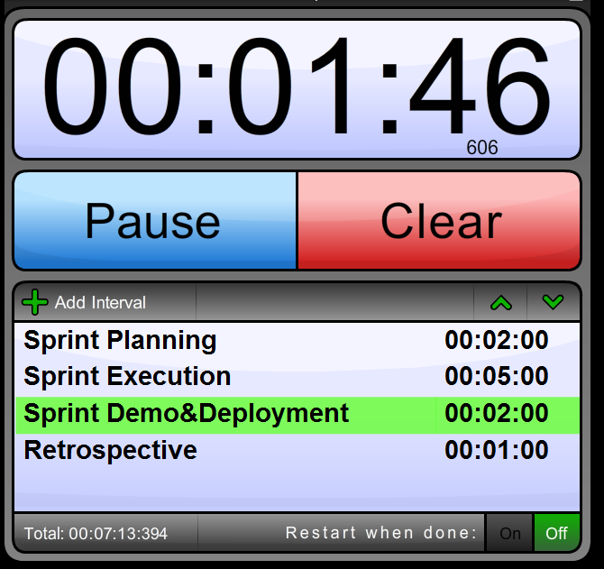
Sprint 2: Optimizing the Scrum Team
Move Security to the left - learn about security issues before implementation.
First release into production: Only Release Engineer can deploy.

Slide 18
How Was Sprint 2 For Your Team?

Slide 19
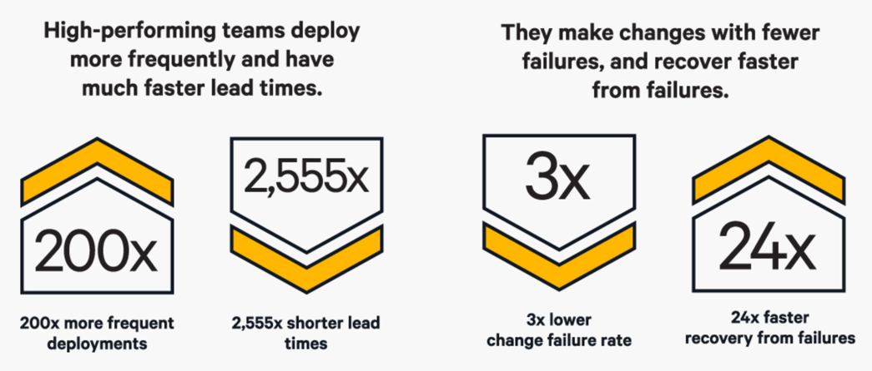
DevOps: Increased Speed
Source: Puppet Labs: State of DevOps Report 2016

Slide 20
DevOps: Increased Stability
Source: Puppet Labs: State of DevOps Report 2016

Slide 21
DevOps
“A mix of patterns intended to improve collaboration between development and operations. DevOps addresses shared goals and incentives as well as shared processes and tools.”
~ Michael Hüttermann

Slide 22





2016 - No Longer For Unicorns Only…
Macy’s, Nordstrom,
GE Capital, Disney,
US Department of Homeland Security,
IBM, Microsoft,
Barclays Capital,
Capital One,
Target, Walmart…
2009 - 2011
Notes:
DevOps movement came a long way since 2009.
2009 – 10 deploys per day at Flickr
2011 – 11.6 sec → over 7 K deployments per day
2016 – Information from DevOps Enterprise summit. – all these companies are implementing Devops practices now and accelerating their delivery of services.
And if the Department of Homeland Security can do it, so can you!
Let’s get some experience with DevOps transformation by playing a close-to real life DevOps transformation RPG

Slide 23

Ready for DevOps? How Do You
?

Slide 24
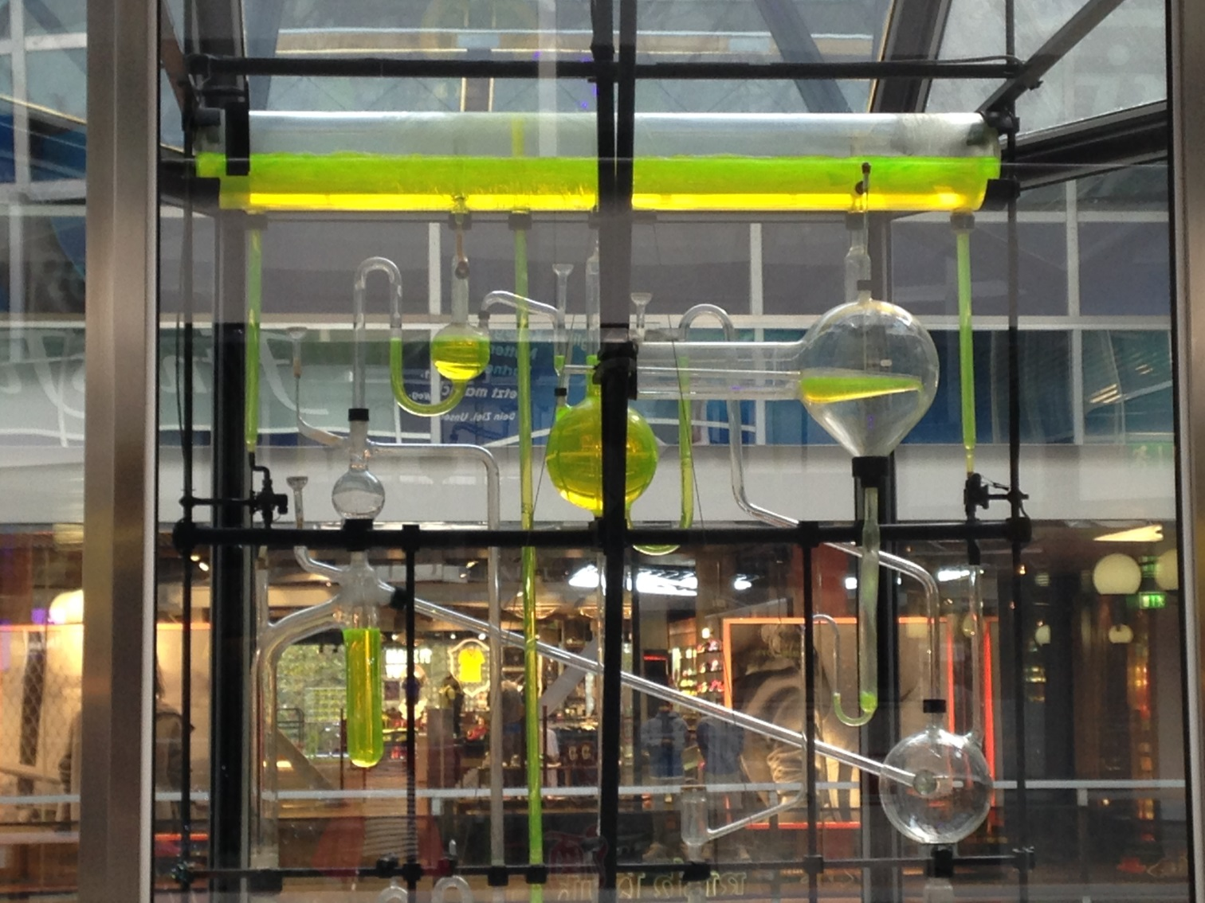
Optimize Your Flow
Any improvement not made at the constraint is an illusion
“The Phoenix Project”
Notes:
Start with visualizing your flow. Get a better understanding of how a value delivering planned work moves through your organization. Learn to optimize that.
Understand where unplanned work causes the most disruption and how you can minimize it’s impact.
Think about all the places were you may have non-value added work and your biggest constraint.

Slide 25

Beware of different types of bottleneck!
Notes:
Be aware of different types of constraints:
Tool: The way existing tools are used and/or lack of appropriate tools may limit the ability of the system to produce more.
People: Lack of skilled people limits the system. Mental models held by people can cause behavior that becomes a constraint.
Policy: A written or unwritten policy prevents the system from making more.

Slide 26





Enable Dev and Ops Collaboration
Dev
Ops
Scrum Team
Cross-train, Build T-shaped skills

Slide 27

Split Work into Smaller Batches

Slide 28
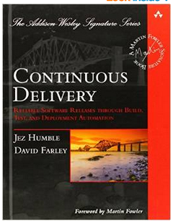
Simplify and Automate Your Deployments

Slide 29
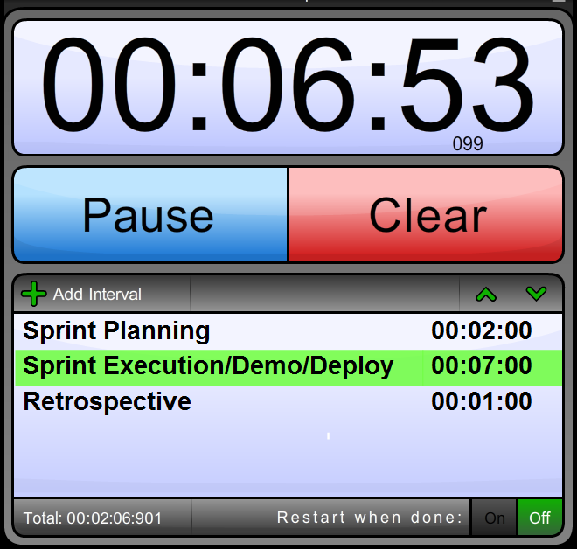
Sprint 3: DevOps Transformation.
Build T-shaped skills.
Reduce batch sizes.
Accelerate the feedback loop with simplified deployment.

Slide 30
Final Debriefing

Slide 31

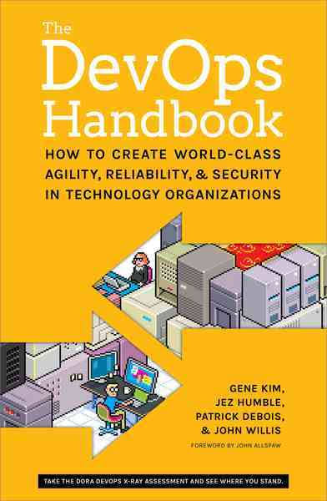


Recommended Reading:

Slide 32
Links and Credits
https://www.getchef.com/blog/2010/07/16/what-devops-means-to-me/
https://puppet.com/resources/white-paper/2016-state-of-devops-report
https://blog.newrelic.com/2014/05/16/devops-name/
http://continuousdelivery.com/
https://pixabay.com/
http://vectorcharacters.net/

Slide 33


